Slide 1
SimplyRhino, London
February 12-14, 2020
Python Scripting for
Rhino/Grasshopper
Long Nguyen

Slide 2
Rebrand.Ly/Python202002

Slide 3
Overview
Essential Python programming concepts: variable, data, data types, conditional statements, loops, function, data structure
The Python code editor in Rhino and Grasshopper
Intro to RhinoCommon Library
Diving deeper into Rhino geometries: Curve, Mesh, Surface, Brep
Objected-oriented programming in Python
Using Python with Grasshopper timer
Randomness
Generating and editing texts
Reading/writing files

Slide 4
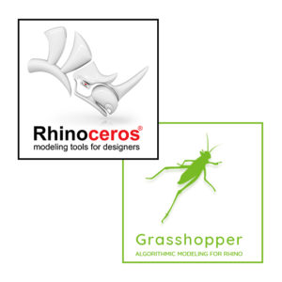


Three categories
Python language
Algorithms
Rhino/Grasshopper API programming library

Slide 5
Python in Rhino

Slide 6
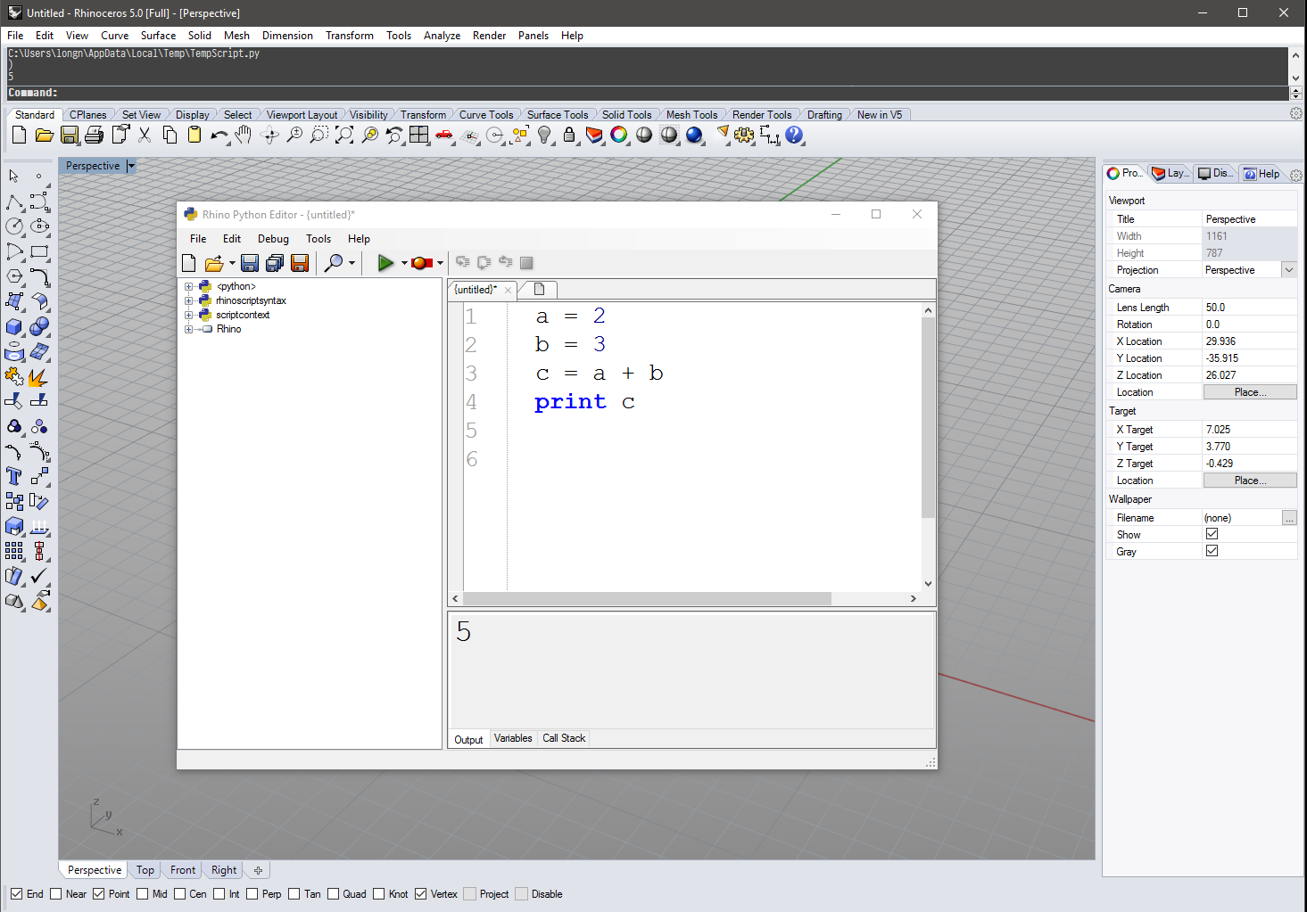
The Python Code Editor in Rhino

Slide 7
Our very first script: Hello World!
Script
print "Hello World!"
Output Panel
Hello World!

Slide 8
Our very first script: Hello World!
Script
print "Hello World!"
print "Welcome to London"
Output Panel
Hello World!
Welcome to London

Slide 9
Variables
a = 2
print a
b = 3.2
print b
a = "Hello"
print a
Think of a variable is a container that store a certain value
a
b
"Hello"
2
3.2
2
3.2
Hello

Slide 10
Data Types
a = 2
print a
b = 3.2
print b
a = "Hello"
print a
c = True
Integer (int)
float
string
boolean (bool)
Later we will see data types defined by the Rhino programming library (RhinoCommon):
Point3d, Vector3d, Mesh, Brep, RhinoDoc

Slide 11
Variable’s name vs. text
print "a"
a = 2
print a
a
2

Slide 12
What if …
print a
a = 2
Message: name 'a' is not defined
Traceback:
line 1, in <module>, "C:\Users\longn\AppData\Local\Temp\TempScript.py"

Slide 13
Arithmetic operators
a = 2
b = 3
c = a + b
print c
c = c + 2
print c
d = c * 3
print d
5
7
21

Slide 14
Commenting the code
# This is a comment
a = 2
b = 3
c = a + b
print c
c = c + 2
# This is a another comment
print c
d = c * 3
print d

Slide 15
Using comments to “disable” a line of code
# This is a comment
a = 2
b = 3
c = a + b
print c
c = c + 2
# This is a another comment
print c
#d = c * 3
print d

Slide 16
Logical Operator
a = True
b = False
c = a or b
d = a and b
d = not d
Comparision operators
a = 3
b = 2
c = a > b #True
print a > 4 #False
print a == 3 #True
print a == 3 and c #True
print b and c #True

Slide 17
Conditional Statement
a = 3
b = 2
if a > b:
print "a is larger than b"
a = 3
b = 2
if a > b:
print "a is larger than b"
else:
print "a is not larger than b"

Slide 18
Nested Conditional Statements
a = 3
b = 2
c = 1
# Find the largest number among a, b and c
if a > b:
if a > c:
print "a is largest"
else:
print "c is largest"
else: # b > a
if b > c:
print "b is largest"
else:
print "c is largest"

Slide 19
Python in Grasshopper

Slide 20
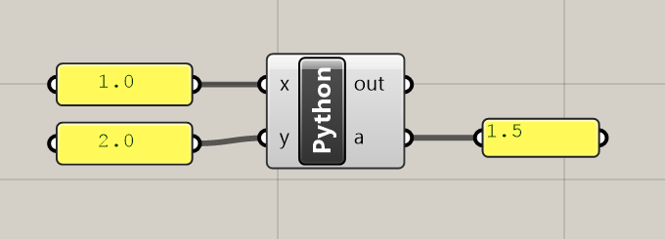
Simple Example: Compute the average of two numbers
INPUTS
x: float
y: float
OUTPUTS:
a
average = 0.5 * (x + y)
a = average

Slide 21
Using RhinoCommon from Python (in Grasshopper)

Slide 22
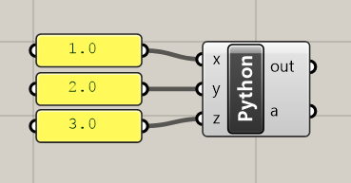
Create a point
INPUTS
x: float
y: float
z: float
OUTPUTS:
a
BEHIND THE SCENE:
“myPoint” is the a variable/container that store a value of type Point3d
myPoint
Point3d(1.0, 2.0, 3.0)
import Rhino.Geometry as rg
myPoint = rg.Point3d(1.0, 2.0, 3.0)
a = myPoint

Slide 23
Create a point
INPUTS
x: float
y: float
z: float
OUTPUTS:
a
BEHIND THE SCENE:
“myPoint” is the a variable/container that store a value of type Point3d
a
Point3d(1.0, 2.0, 3.0)
import Rhino.Geometry as rg
myPoint = rg.Point3d(x, y, z) # Use input parameters
a = myPoint

Slide 24
Point3d properties and methods
import Rhino.Geometry as rg
myPoint = rg.Point3d(x, y, z)
a = myPoint
print myPoint.X # accessing the X coordinate of myPoint

Slide 25
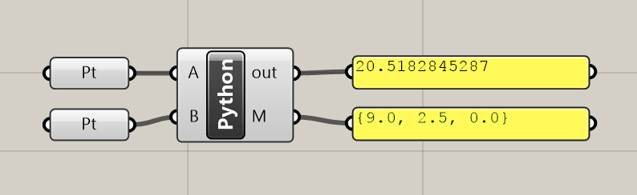
Compute mid-point between two points and the distance in between
INPUTS
A: Point3d
B: Point3d
OUTPUTS:
M
import Rhino.Geometry as rg
midX = 0.5 * (A.X + B.X)
midY = 0.5 * (A.Y + B.Y)
midZ = 0.5 * (A.Z + B.Z)
M = rg.Point3d(midX, midY, midZ)
distance = A.DistanceTo(B)
print distance
Alternatively:
M = 0.5 * (A + B)

Slide 26
Some other Rhino Geometry data types
INPUTS
none
OUTPUTS:
oPlane
oCircle
import Rhino.Geometry as rg
myVector = rg.Vector3d(0.0, 1.0, 0.0)
myPoint = rg.Point3d(2.0, 2.0, 2.0)
myPlane = rg.Plane(myPoint, myVector)
oPlane = myPlane
myCircle = rg.Circle(myPlane, 3)
oCircle = myCircle

Slide 27
Data types are important!
Plane(Point3d, Vector3d)
Plane(Point3d, Vector3d, Vector3d)
Plane(Point3d, Point3d, Point3d)
Circle(float)
Circle(Point3d, float)
Circle(Plane, float)
A function/command can have more than one variant.
Each variant takes in a different set of parameters.
Python determines which is the right version to use SOLELY based on the data types of the input parameters

Slide 28
List storing multiple items in “one” item

Slide 29
What is a list?
A list allows us to store multiple items in a sequence
The list itself can be treated like a single item
heroes = ["Batman", "Wolverine", "Superman"] # Create a list of three string values and
store the list in the variable named heroes
print heroes # Textually display the content of the list
# Retrieve items from the list
firstHero = heroes[0]
lastHero = heroes[-1]
# Retrieve a sublist
sublist = heroes[0:2] # This will give a smaller list: ["Batman", "Wolverine“]

Slide 30
Lists functions
Let’s start with this list that contains the name of three superheroes
heroes = ["Batman", "Wolverine", "Superman"]
Modifying an existing element in the list
heroes[1] = “Thor” # Change the 1st hero (i.e. Wolverine) to Thor
Adding and removing elements to a list
heroes.append(“Captain America”) # Add a single new element to the end of the list
heroes.extend( [“Ant Man”, “Robin”] ) # append a new list to the current list
heroes.insert(1, “Hulk”) # Insert “Hulk” between “Batman” and “Wolverine”
heroes.remove(“Superman”)

Slide 31
Other useful list functions
heroes = ["Batman", "Wolverine", "Superman"]
...
n = heroes.count("Batman") # Count how many times "Batman" appears in the list
heroes.sort() # Sort the items (in-place)
heroes.reverse() # Reverse the list (in-place)
elementCount = len(heroes) # Get the total length of the list

Slide 32
List and Rhino geometries
import Rhino.Geometry as rg
points = []
points.append(rg.Point3d(1.0, 1.0, 0.0))
points.append(rg.Point3d(2.0, 2.0, 0.0))
points.append(rg.Point3d(3.0, 3.0, 0.0))
points.append(rg.Point3d(4.0, 4.0, 0.0))
oPoints = points

Slide 33
Loops

Slide 34
“For” loop
print 0
print 1
print 2
print 3
print 4
for i in [0, 1, 2, 3, 4]:
print i
=
Output Panel
0
1
2
3
4

Slide 35
Creating geometries using for loop
import Rhino.Geometry as rg
points = []
for i in range(0, 50):
myPoint = rg.Point3d(i, i, 0)
points.append(myPoint)
oPoints = points

Slide 36
Live example: List, loop and some maths

Slide 37
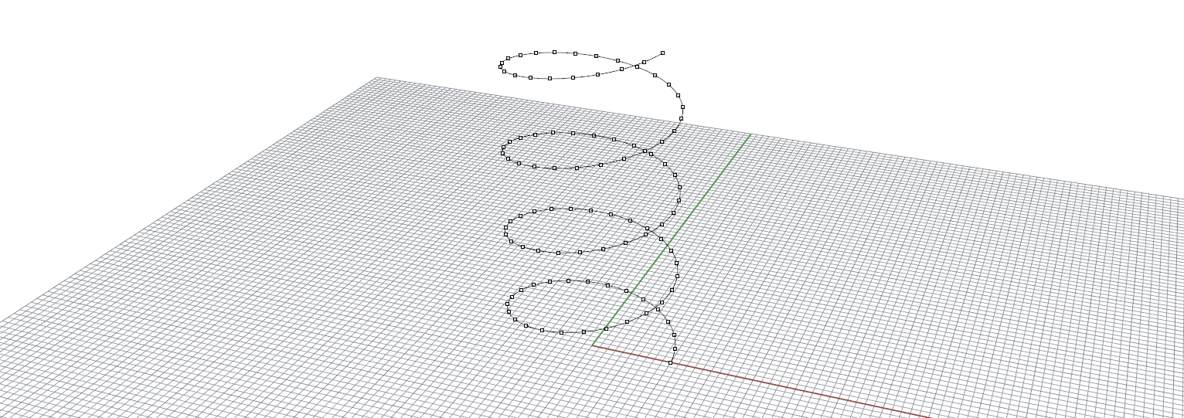
Create and list of points using a “for” loop with some simple math rules
Draw a curve through these points

Slide 38
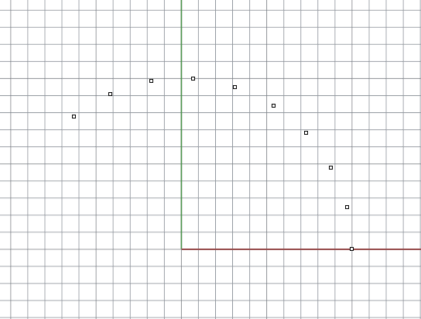
Live Example: Create a list using for loop
Step 1: Create points along a circle
import Rhino.Geometry as rg
import math
points = []
for i in range(0, 10):
alpha = i * 0.25
x = 10 * math.cos(alpha)
y = 10 * math.sin(alpha)
z = 0
points.append(rg.Point3d(x, y, z))
oPoints = points
Y
INPUTS
none
OUTPUTS:
oPoints
oCurve
i = 3
X
alpha

Slide 39
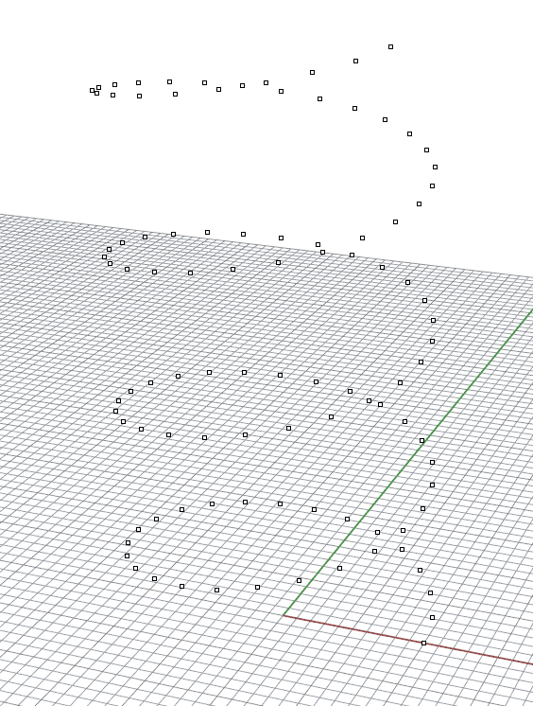
Live Example: Create a list using for loop
Step 2: raising the z coordinates to create the helix
import Rhino.Geometry as rg
import math
points = []
for i in range(0, 100):
alpha = i * 0.25
x = 10 * math.cos(alpha)
y = 10 * math.sin(alpha)
z = i * 0.4
points.append(rg.Point3d(x, y, z))
oPoints = points
INPUTS
none
OUTPUTS:
oPoints
oCurve

Slide 40
Live Example: Create a list using for loop
Step 3: draw a curve
import Rhino.Geometry as rg
import math
points = []
for i in range(0, 100):
alpha = i * 0.25
x = 10 * math.cos(alpha)
y = 10 * math.sin(alpha)
z = i * 0.4
points.append(rg.Point3d(x, y, z))
oPoints = points
oCurve = rg.NurbsCurve.CreateInterpolatedCurve(points, 3)
INPUTS
none
OUTPUTS:
oPoints
oCurve

Slide 41
Live example: Lists as input parameters

Slide 42
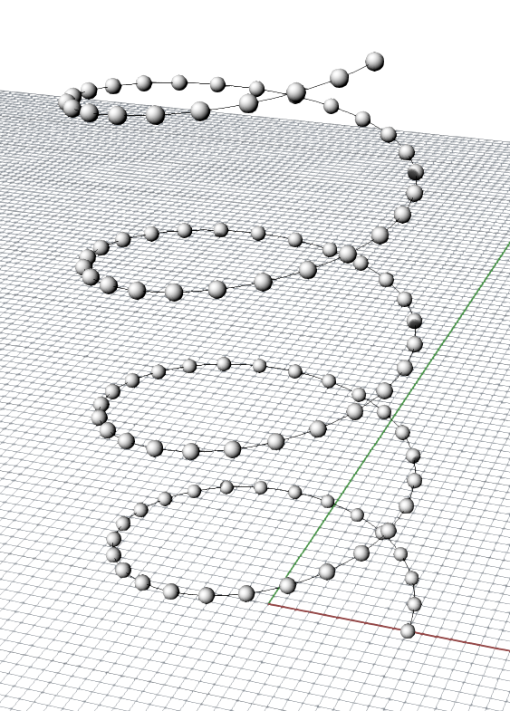
Live Example: Lists as input parameters
INPUTS
iPoints: List of Point3d
OUTPUTS:
oSpheres
import Rhino.Geometry as rg
spheres = []
for i in range(0, len(iPoints)):
center = iPoints[i]
mySphere = rg.Sphere(center, 0.5)
spheres.append(mySphere)
oSpheres = spheres

Slide 43
Live Example: Lists as input parameters
Accessing element of a list without knowing the current index i
INPUTS
iPoints: List of Point3d
OUTPUTS:
oSpheres
import Rhino.Geometry as rg
spheres = []
for point in iPoints:
center = point
mySphere = rg.Sphere(center, 0.5)
spheres.append(mySphere)
oSpheres = spheres

Slide 44
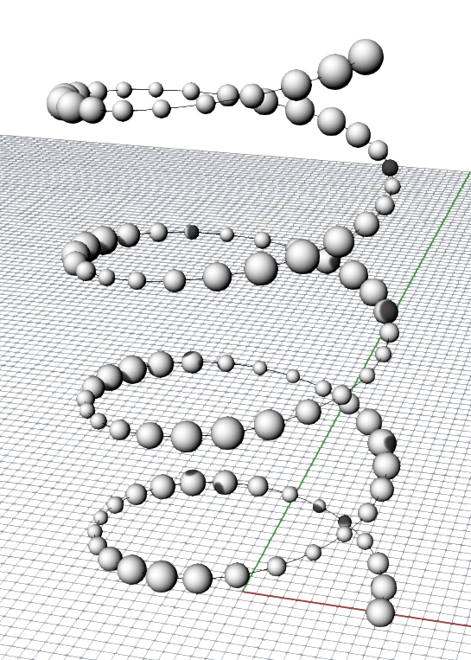
Live Example: Lists as input parameters
… but, with the index i we can do extra stuff
INPUTS
iPoints: List of Point3d
OUTPUTS:
oSpheres
import Rhino.Geometry as rg
import math
spheres = []
for i in range(0, len(iPoints)):
center = iPoints[i]
r = 0.75 + 0.25 * math.cos(i)
mySphere = rg.Sphere(center, r)
spheres.append(mySphere)
oSpheres = spheres

Slide 45
Two common list programming patterns

Slide 46
Summation/Accumulation/Aggregation
Let’s say we have a list of numbers
numbers = [2, 3, 2, 1, 6, 9, 8, 2]
We can use for loop to compute the sum of all elements
sum = 0
for i in range(0, len(numbers)):
sum = sum + numbers[i]
print sum
Equivalently …
sum = 0
for number in numbers:
sum += number
print sum

Slide 47
Summation/Accumulation
Compute the centroid of a set of input points
INPUTS
iPoints: List of Point3d
OUTPUTS:
oCentroid
import Rhino.Geometry as rg
centroid = rg.Point3d(0, 0, 0)
for point in iPoints:
centroid += point
centroid /= len(iPoints)
oCentroid = centroid

Slide 48
Finding the “extreme” element
Let’s say we have a list of numbers
numbers = [2, 3, 2, 1, 6, 9, 8, 2]
Find the smallest number
smallest = numbers[0]
for number in numbers:
if number < smallest:
smallest = number
print smallest

Slide 49
Finding the “extreme” element
Finding the nearest point relative to a reference point
INPUTS
iPoints: List of Point3d
iReference: Point3d
OUTPUTS:
oNearest
nearest = iPoints[0]
for point in iPoints:
if point.DistanceTo(iReference) < nearest.DistanceTo(iReference):
nearest = point
oNearest = nearest

Slide 50
Nested Loops

Slide 51
Nested loops: A for loop within a for loop
for i in range(0, 2):
print "i = " + i
for j in range(0, 3):
print " j = " + j
i = 0
j = 0
j = 1
j = 2
i = 1
j = 0
j = 1
j = 2

Slide 52
Creating a 2D grid of points
import Rhino.Geometry as rg
import math
points = []
for i in range(0, 50):
for j in range(0, 50):
points.append(rg.Point3d(i, j, 0.0))
oGeometry = points
INPUTS
none
OUTPUTS:
oGeometry

Slide 53
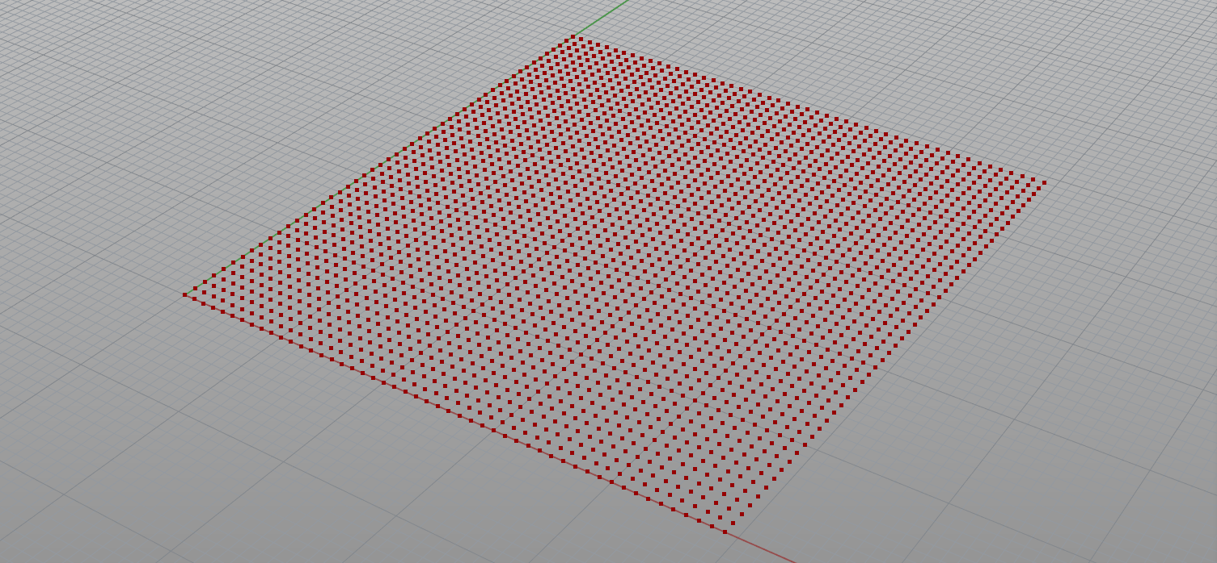
Creating a 2D grid of points

Slide 54
Adjusting the heights to create wavy effect
import Rhino.Geometry as rg
import math
points = []
for i in range(0, 50):
for j in range(0, 50):
z = math.sin(i * 0.4) * math.sin(j * 0.7)
points.append(rg.Point3d(i, j, z))
oGeometry = points
INPUTS
none
OUTPUTS:
oGeometry

Slide 55
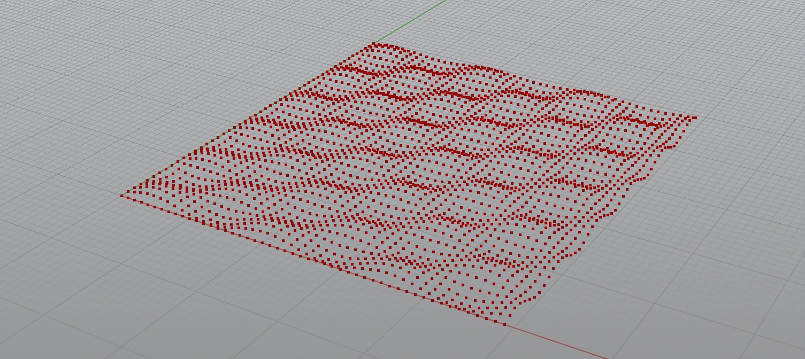
Adjusting the heights to create wavy effect

Slide 56
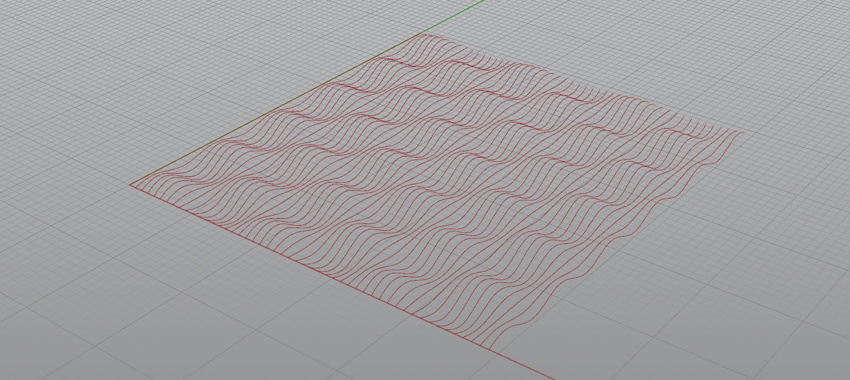
Creating a list of wavy curves

Slide 57
Creating a list of wavy curves
import Rhino.Geometry as rg
import math
curves = []
for i in range(0, 50):
points = []
for j in range(0, 50):
z = math.sin(i * 0.4) * math.sin(j * 0.7)
points.append(rg.Point3d(i, j, z))
curve = rg.NurbsCurve.CreateInterpolatedCurve(points, 3)
curves.append(curve)
oGeometry = curves
INPUTS
none
OUTPUTS:
oGeometry

Slide 58
Creating a loft surface from the wavy curves
import Rhino.Geometry as rg
import math
curves = []
for i in range(0, 50):
points = []
for j in range(0, 50):
z = math.sin(i * 0.4) * math.sin(j * 0.7)
points.append(rg.Point3d(i, j, z))
curve = rg.NurbsCurve.CreateInterpolatedCurve(points, 3)
curves.append(curve)
brep = rg.Brep.CreateFromLoft(curves, rg.Point3d.Unset, rg.Point3d.Unset, rg.LoftType.Normal, False)
oGeometry = brep

Slide 59
Nested Lists

Slide 60
Nested list: a list whose elements are also lists!
Define a nested list
myNestedList = [ [0, 1], [2, 3, 4], [2] ]
Or, equivalently…
myNestedList = []
myNestedList.append([0, 1])
myNestedList.append([2, 3, 4])
myNestedList.append([2])

Slide 61
Retrieving elements from a nested list
myNestedList = [ [0, 1], [2, 3, 4], [2] ]
firstSublist = myNestedList[1] # This will give the sublist [2, 3, 4]
n = myNestedList[1][0] # This will give the zeroth element in the first sublist

Slide 62
Nested List: an multidimensional structure to store stuff
A matrix can be described naturally by a nested list
( )
0 2 4
1 3 5
myMatrix =
myMatrix = [ [0, 2, 4], [1, 3, 5] ]
Retrieving an item from the matrix is just a matter of using the index operator (the “square-bracket” operator)
# Retrieve the item at the zeroth row, first column
item = myMatrix[0][1]
print item # This will display “2”

Slide 63
Nested List: an multidimensional structure to store stuff
Guess what, we can store a 2D array of Point3d in a 2D nested list too
Y
A B C
D E F
points = [ [A, B, C], [D, E, F] ]
X
# Retrieve the point at the first row, second column
p = points[1][2]

Slide 64
Previously, we stored a 2D array of points in a 1D list
import Rhino.Geometry as rg
import math
points = []
for i in range(0, 50):
for j in range(0, 50):
z = math.sin(i * 0.4) * math.sin(j * 0.7)
points.append(rg.Point3d(i, j, z))
oGeometry = points

Slide 65
Doing math using 2D indices are kinda easier
Lets say we want to create a diagrid pattern based on a 2D array of point

Slide 66
Doing math using 2D indices is kinda easier
Lets say we want to create a diagrid pattern based on a 2D array of point
[i][j+1]
[i+1][j+1]
[i][j]
[i+1][j]

Slide 67
Doing math using 2D indices are kinda easier
import Rhino.Geometry as rg
import math
points = []
for i in range(0, 50):
row = []
for j in range(0, 50):
z = math.sin(i * 0.4) * math.sin(j * 0.7)
row.append(rg.Point3d(i, j, z))
points.append(row)
oGeometry = points

Slide 68
Doing math using 2D indices are kinda easier
# ... continue from previous example
lines = []
for i in range(0, 49):
for j in range(0, 49):
line = rg.Line(points[i][j], points[i + 1][j + 1])
lines.append(line)
line = rg.Line(points[i + 1][j], points[i][j + 1])
lines.append(line)
oGeometry = lines

Slide 69
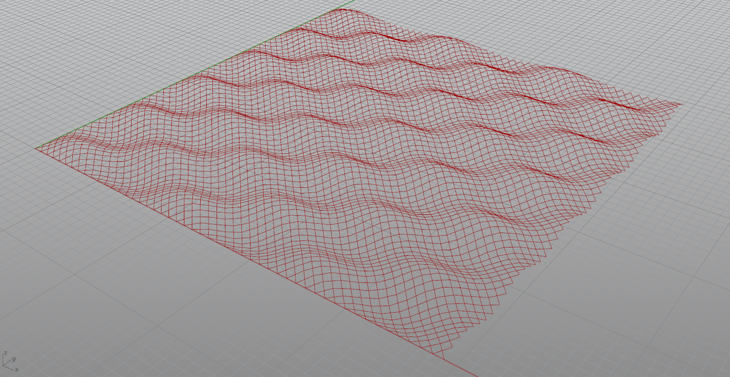

Slide 70
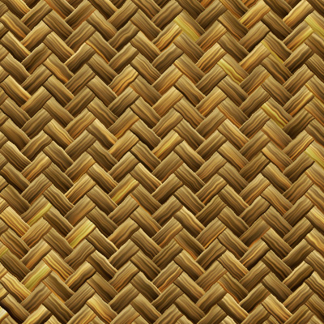
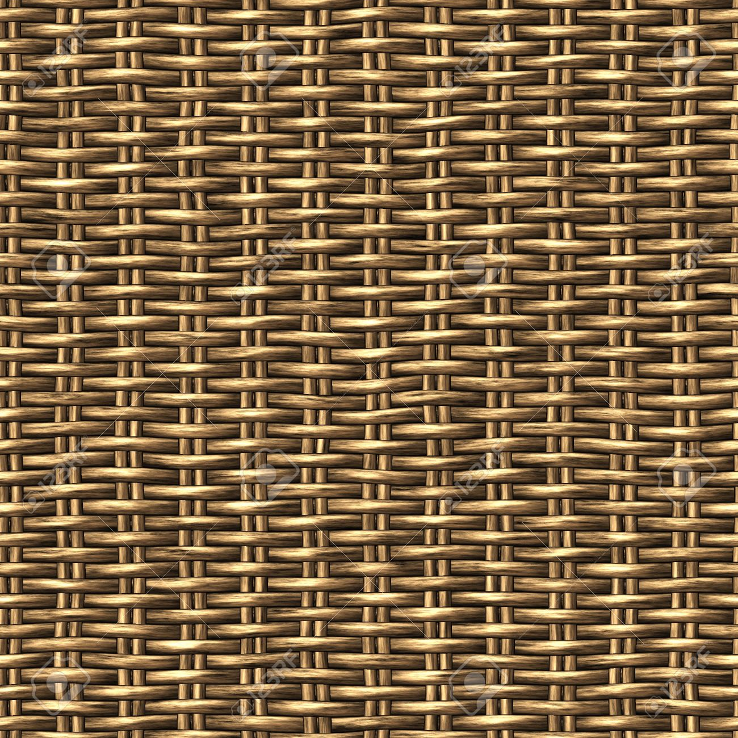
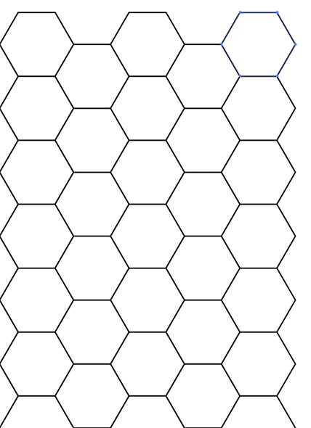
Playing with 2D indexing logic Endless patterned geometry possibilities

Slide 71
Functions

Slide 72
Sometimes codes need to be repeated multiple times
# Compute the average of a list of numbers
myNumbers = [2, 3, 4, 5]
sum = 0
for number in myNumbers
sum += number
average = sum / len(myNumbers)
print average
# Compute the average of Another list of numbers
yourNumbers = [5, 0, 1, 2]
sum = 0
for number in yourNumbers
sum += number
average = sum / len(yourNumbers)
print average
Output Panel
3.5
4

Slide 73
Functions: Package and reuse codes!
def ComputeAverage(numbers):
sum = 0
for number in numbers:
sum = sum + number
average = sum / len(numbers)
print average
ComputeAverage([2, 3, 4, 5])
ComputeAverage([5, 0, 1, 2])
# Terminology: argument
Output Panel
3.5
4

Slide 74
Functions can have an output:
def ComputeAverage(numbers):
sum = 0
for number in numbers:
sum += number
average = sum / len(numbers)
return average
result1 = ComputeAverage([2, 3, 4, 5])
result2 = ComputeAverage([5, 0, 1, 2])
# Do whatever you want with result1 and result2
print result1
print result2
Output Panel
3.5
4

Slide 75
Function can have multiple inputs, but only one output at most (But we can easily work around this)
def ComputeCylinderAreaAndVolume(r, h):
area = 3.14 * r * r * 2 + 3.14 * r * 2 * h
volume = 3.14 * r * r * h
return (area, volume) # Package area and volume into a tuple
result = ComputeCylinderAreaAndVolume(2.1, 3.4)
area = result[0]
volume = result[1]

Slide 76
Function naming convention
def ComputeCylinderAreaAndVolume(r, h):
area = 3.14 * r * r * 2 + 3.14 * r * 2 * h
volume = 3.14 * r * r * h
return (area, volume)
Function name should use upper casing
Function name typically should contains a verb
Input parameter name should use camel casing (first letter is lower case and every new word start with upper case)

Slide 77
Function is like a black box
r
ComputeCylinderVolume
?
volume
h
Hide the implementation details away

Slide 78
Function with RhinoCommon Geometry
def ComputeMidPoint(A, B):
return (A + B) * 0.5

Slide 79
Invoke a function from within another function
import Rhino.Geometry as rg
def ComputeMidPoint(A, B):
return (A + B) * 0.5
def CreateMidLine(A, B, C, D):
M = ComputeMidPoint(A, B)
N = ComputeMidPoint(C, D)
return rg.Line(M, N)
oMidLine = CreateMidLine(A, B, C, D)
A
C
M
N
B
D

Slide 80
Three types of function that you will commonly see
# Type 1: normal Python functions that we have been dealing with today
ComputeCylinderAreaAndVolume(20, 2.0)
# Type 2: a function that is associated with specific data type (methods)
# For example: The method DistanceTo(), defined for datatype Point3d
myPoint3d.DistanceTo(yourPoint)
# Type 3: static function (static method) of a class
rg.Vector3d.Cross(myVector, yourVector)
rg.Curve.CreateInterpolatedCurve(...)

Slide 81
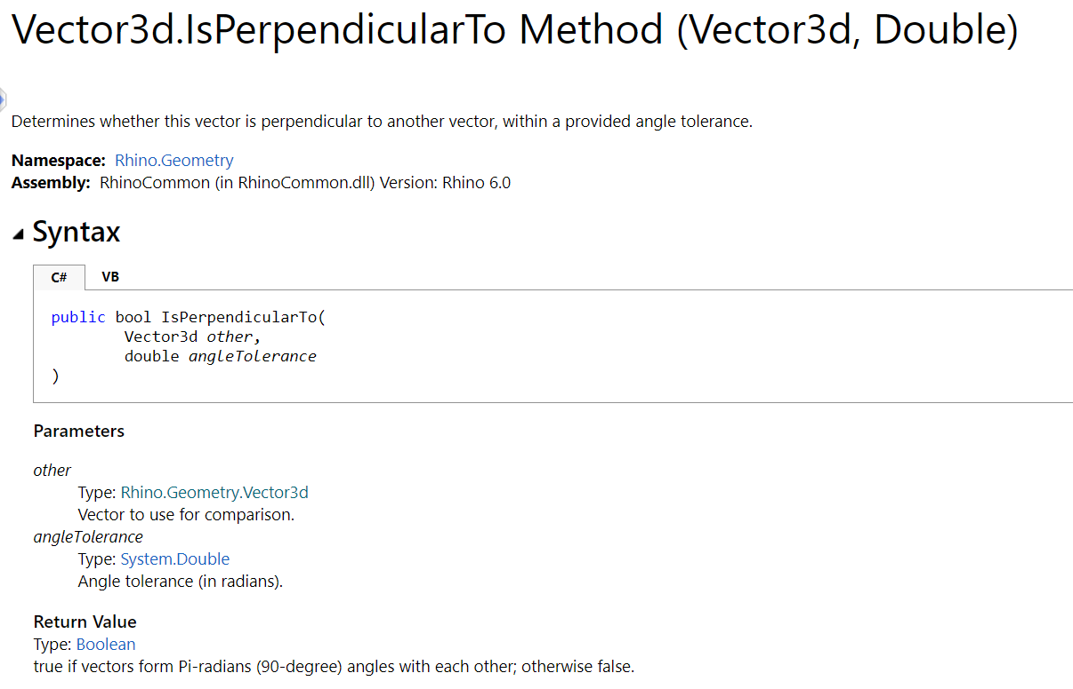
Predefined functions from the RhinoCommon library

